Slide 1


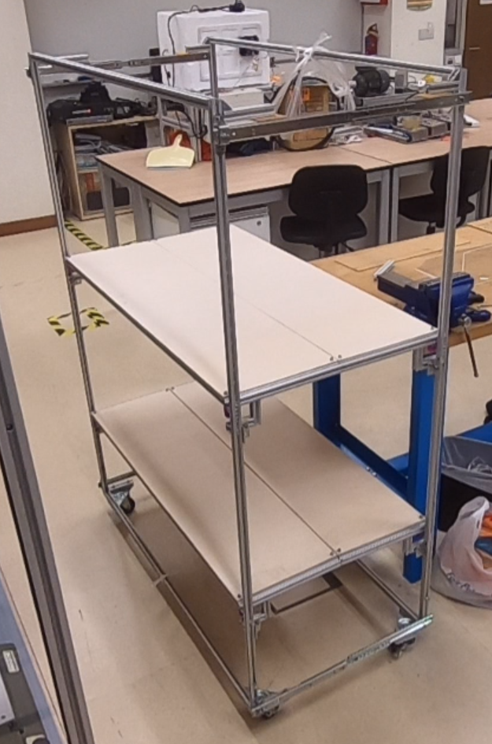
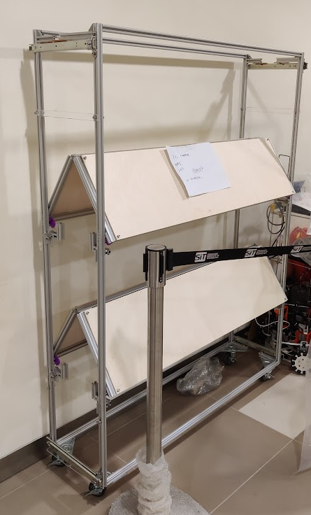
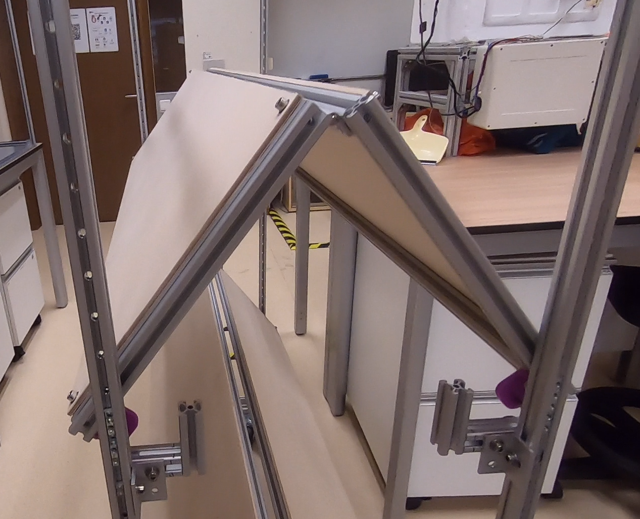
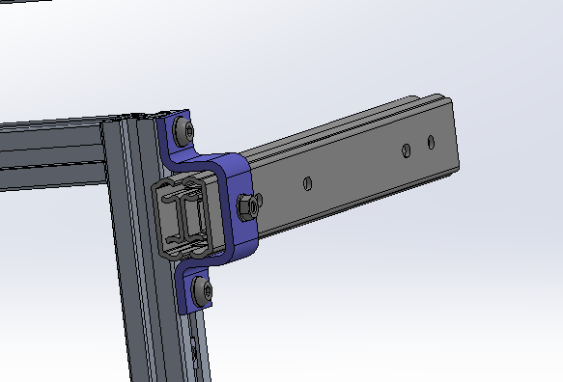
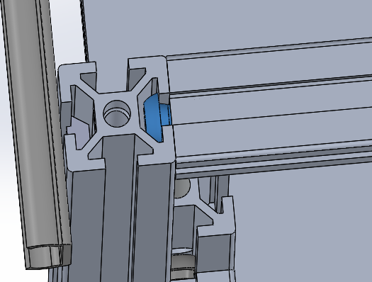
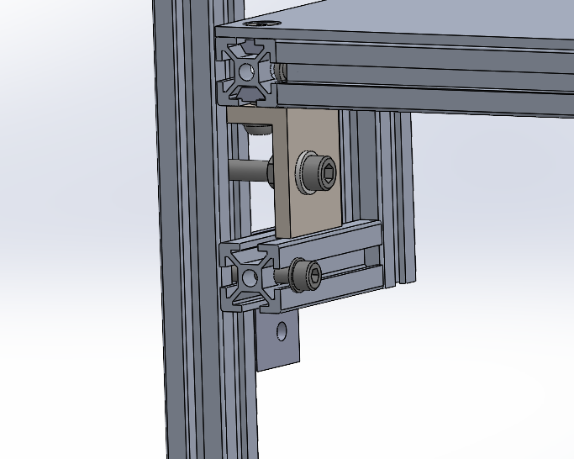
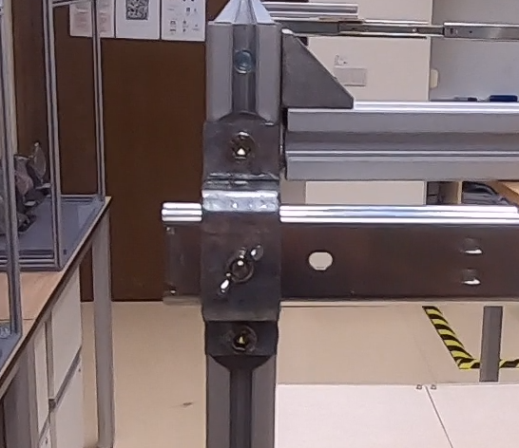
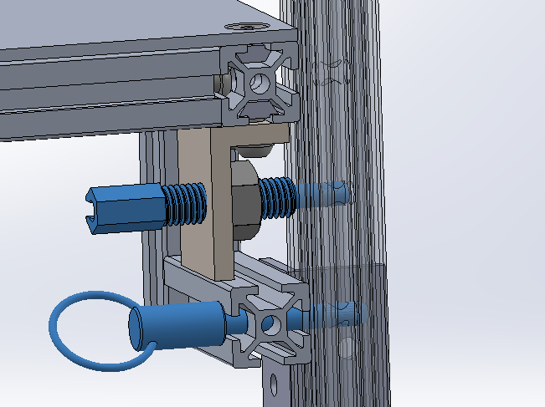
Student: Chew En Yu, 1901438
Supervisors: Dr Kyrin Liong
Dr Steven Tay
Design of a Compressible Storage System
1
Background
Prototype
At CGH, a mobile storage system is used. It is set at a designated location.
With the nature of a hospital setting, very week, the storage system has to be washed and sanitized at a different location. And as the hospital runs 24/7, another unit immediately takes its place.
After washing, having had a unit take its place, this unit is stored in a store room.
Unfortunately, this is an inefficient usage of space, as these spare units are not in active use.
A storage system that may be compressed when not in use would be beneficial.
The prototype is made using the aluminium profile system for its structure. The list of sub assemblies are:
Frame
Frame extension mechanism
Shelf
Shelf support
Caster wheels
The dimensions are:
Height, depth, length
165, 60, 120cm
When compressed, depth decreases to 36cm, a 40% compression.
2
Shelf design
A storage system that is compressible using foldable shelves and telescopic rails is made.
3
Frame extension
4
Aluminium profile system
The shelves are split in two, using a hinge to join the two halves, this allows the frame to be compressed together.
Aluminium profiles are used for the structure. Seen here are connecting bolts for angle joint. Pre and post assembly nuts, angle brackets are used as well for joints.
The modularity allows for future design changes and reusing of material for other projects.
Pin connections between the shelf and the frame allows for the rotation upwards.
And a support structure provides robustness and transfers the loads to the frame.
5
Usage
The extension mechanism, or slide rail, is attached using a bracket to the frame on one side.
The use of slide rails allow the two frame halves to remain parallel to each other, and allow for smooth motion during the compression and extension process.
For the compression operation:
The caster wheels on at least 1 side must be unlocked.
The shelves mid section are lifted up, and this will begin the compression.
Lastly, a latch is pulled down to lock and hold the two halves together.
To extend:
The caster wheels on at least 1 side must be unlocked.
The latch is to be released
The frame can be pulled apart from each other.
The storage system can be moved about when compressed or deployed.
The usage of pins allow the quick removal of the shelves, and equal distanced holes along the frame’s vertical posts allow the shelves to be set at various heights to better accommodate and efficiently store inventory.

